Slide 1
Chapter 13
Organizing the MIS Resources

Slide 2
Outline
How is an MIS department managed?
Is the MIS department doing a good job?
What roles and tasks does the MIS department perform?
What MIS jobs are available, and how much will it cost to hire IT employees?
Do you really need to run all of the MIS operations yourself?
Who should control IT resources?
How can Internet technologies be used internally to centralize data but still support decentralized user access?
Why is the MIS department involved in so many conflicts? How do you solve them?

Slide 3







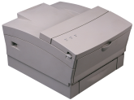






Organizing IS Resources

Slide 4



MIS Roles
Hardware administration
Software support
Network management
Software development
End user support
E-business/Internet
DB administration
Advocacy
Security
Advocacy
Database
administration
Network management
Software
development
Internet and e-business
Hardware administration and operations
Security
Support end user
development
Software training
and support

Slide 5
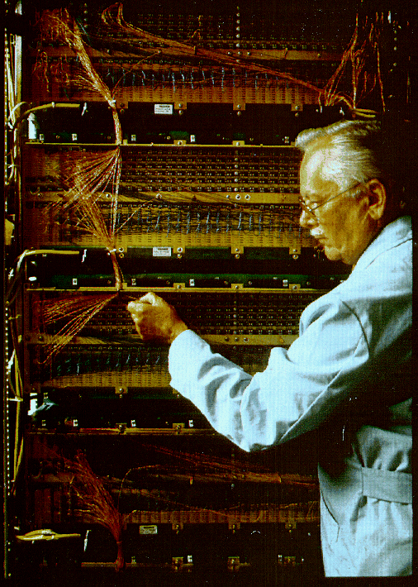
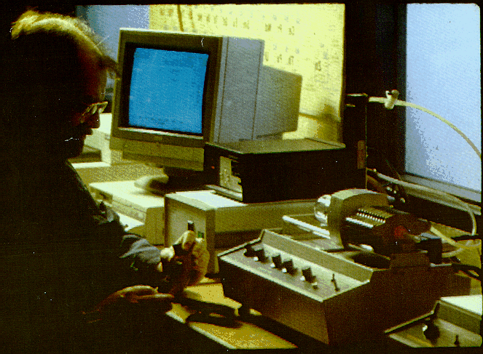

Some MIS Roles
Hardware Repair
Network and Telecommunications
Training and User Support

Slide 6
Managing IS
Managing Workers
Hiring, Evaluating, Training
Are IT certifications useful?
No good answer. Are employers looking for narrowly-defined list of skills, or intelligent, adaptable workers?
Planning and Integration
A start of the discussion on centralization v. decentralization.
MIS needs to fit within the organizational structure.
Evaluation, Oversight, and Control
User satisfaction evaluation of IT.
Chargeback (transfer pricing).
Difficult to set correct prices.
Gives some control (yes/no) to users.
IT oversight committees

Slide 7
Salaries 1995
IS Management
CIO/VP IS $91,568
Director
IS Operations 72,982
Networks 70,050
Systems Development 72,982
Operations
Networks
Systems Development
User Support
Computer manager $49,545
Supervisor 39,525
Lead operator 30,304
Operator 25,383
Technical specialist 36,801
Telecom. manager $60,278
Telecom. specialist 46,974
Network administrator 42,880
LAN manager 46,802
Project manager $58,386
Sr. systems analyst 51,910
Systems analyst 45,416
Sr. systems program. 51,731
Systems programmer 41,887
Sr. programmer/analyst 45,981
Programmer/analyst 37,203
Database manager 55,669
Database analyst 47,774
Data security admin. 47,484
Support manager $49,825
Help desk manager 41,756
Help desk operator 29,486
PC technical specialist 33,045
Business analyst 37,205
Computerworld 1995 Salary Survey

Slide 8
Salaries 1997-1998
IS Management
CIO/VP IS $126,000
Director
MIS 94,000
Systems Development 79,500
Includes bonus
Systems Development
Networks
Database
Sr. Project manager $72,000
Project manager 61,500
Systems analyst 52,000
Programmer/analyst 44,500
Programmer 36,000
Telecom. manager $71,000
Telecom. specialist 56,500
Network architect 69,000
LAN/WAN specialist 54,500
Network administrator 45,500
Database manager $74,000
Database administrator 61,000
Database analyst 55,000
User Support
Operations
Specialists
Support manager $55,000
Help desk manager 47,500
Instructor 42,000
PC technical specialist 36,000
Senior manager $61,000
Manager 50,500
Lead operator 35,000
ERP analyst $80,000+
CASE tools 61,000
Systems programmer 54,000
Lotus Notes developer 52,500
Q/A specialist 49,000
Webmaster 47,000
http://careers.wsj.com (Robert Half 1997)
Computerworld 9/7/1998
http://www.computerworld.com

Slide 9
Salaries 1998-1999
IS Management
CIO/VP IS $140,000
Director
MIS 94,000
Systems Development 98,000
Includes bonus
Systems Development
Networks
Database
Sr. Project manager $76,000
Project manager 61,500
Systems analyst 52,000
Programmer/analyst 44,500
Programmer 36,000
Telecom. manager $71,000
Telecom. specialist 57,500
Network architect 69,000
LAN/WAN specialist 57,000
Network administrator 53,000
Database manager $74,000
Database administrator 61,000
Database analyst 55,000
User Support
Operations
Specialists
Support manager $54,000
Help desk manager 49,000
Instructor 42,000
PC technical specialist 37,500
Senior manager $66,000
Manager 50,500
Lead operator 39,000
ERP analyst $80,000+
CASE tools 61,000
Systems programmer 54,000
Lotus Notes developer 52,500
Q/A specialist 49,000
Webmaster 53,000
http://careers.wsj.com (Robert Half 1997)
Computerworld 9/7/1998
http://www.computerworld.com

Slide 10
Salaries 2001
IS Management
CIO/VP IS/CTO $165,000
Includes bonus
Systems Development
Networks
Database
Director $123,000
Manager 88,000
Project manager 85,000
System analyst 79,000
Senior developer 74,000
Programmer/analyst 55,000
Junior programmer 45,000
Director $106,000
Manager 83,000
Administrator 60,000
Network analyst 40,000
Junior analyst 34,000
Manager $94,000
Administrator 89,000
Database analyst 67,000
User Support
Manager $69,000
Help desk operator 40,000
PC technical support 43,000
Internet
Security
Manager $94,000
Webmaster 72,000
Application developer 70,000
EC specialist 74,000
EDI specialist 66,000
Manager $86,000
Administrator 72,000
Specialist 64,000
IS audit manager 81,000
IS audit staff 53,000
Operations
Director $106,000
Manager 74,000
Lead operator 42,000
Computer operator 35,000
http://careers.wsj.com
http://www.computerworld.com

Slide 11
Salaries 2003
IS Management
http://careers.wsj.com
CIO/VP IS/CTO $154,000
Includes bonus
Systems Development
Database
Networks
Director $127,000
Project manager 92,000
System analyst 68,000
Senior developer 76,800
Programmer/analyst 65,000
Junior programmer 45,000
Manager $91,000
Architect 96,000
Analyst 67,900
Manager $67,000
Administrator 54,000
Network engineer 70,600
Junior analyst 34,000
User Support
Security
Manager $88,300
Technical trainer 55,000
Help desk operator 45,800
PC technical support 43,000
Internet
Chief Security $111,000
Manager 85,000
Specialist 75,000
IS audit manager 95,000
IS audit staff 53,000
Director/strategy $112,000
Manager 96,500
Application developer 56,000
EC specialist 70,100
EDI specialist 66,000
Operations
Director $104,500
Manager 82,000
Systems Admin 61,000
Lead operator 40,500
Computer operator 35,000
http://www.computerworld.com
http://www.computerworld.com/careertopics/careers/story/0,,86413,00.html

Slide 12
Salaries 2005
IS Management
CIO/VP IS/CTO $164,000
Includes bonus
Systems Development
Database
Networks
Director $101,000
Project manager 95,000
System analyst 74,000
Senior developer 76,800
Programmer/analyst 71,000
Junior programmer 45,000
Manager $88,000
Architect 95,000
DBA 81,000
Analyst 65,000
Manager $69,000
Administrator 54,000
Network engineer 70,400
Junior analyst 34,000
User Support
Security
Manager $68,300
Technical trainer 54,000
Help desk operator 47,800
PC technical support 43,000
Internet
Chief Security $113,000
Manager 97,000
Specialist 81,000
IS audit manager 91,000
IS audit staff 53,000
Director/strategy $112,000
Manager 96,500
Application developer 56,000
EC specialist 71,000
EDI specialist 66,000
Operations
Director $108,000
Manager 83,000
Systems Admin 61,000
Lead operator 40,500
Computer operator 35,000
http://www.careerjournal.com/
http://www.computerworld.com
http://www.computerworld.com/careertopics/careers/report/0,11188,10242005,00.html

Slide 13
Salaries 2006
IS Management
CIO/VP IS/CTO $175,000
Includes bonus
Systems Development
Database
Networks
Director $120,000
Project manager 97,000
System analyst 74,000
Senior developer 76,800
Programmer/analyst 76,000
Junior programmer 47,000
Manager $88,000
Architect 95,000
DBA 83,500
Analyst 65,000
Manager $78,000
Administrator 55,000
Network engineer 74,000
Junior analyst 34,000
User Support
Security
Manager $77,000
Technical trainer 54,000
Help desk operator 48,000
PC technical support 43,000
Internet
Chief Security $153,000
Manager 97,000
Specialist 82,000
IS audit manager 104,000
IS audit staff 53,000
Director/strategy $116,000
Manager 96,500
Application developer 56,000
EC specialist 76,000
EDI specialist 66,000
Operations
Director $113,000
Manager 82,000
Systems Admin 61,000
Lead operator 40,500
Computer operator 35,000
http://www.careerjournal.com/
http://www.computerworld.com
Computerworld 2006 Salary Survey

Slide 14
Salaries 2007
IS Management
CIO/VP IS/CTO $179,000
Includes bonus
Systems Development
Database
Networks
Director $120,000
Project manager 105,000
System analyst 74,000
Senior developer 76,800
Programmer/analyst 90,800
Junior programmer 47,000
Manager $88,000
Architect 95,000
DBA 83,700
Analyst 65,000
Manager $80,000
Administrator 57,700
Network engineer 74,000
Junior analyst 34,000
User Support
Security
Manager $77,000
Technical trainer 54,000
Help desk operator 48,000
PC technical support 43,000
Internet
Chief Security $153,000
Manager 103,000
Specialist 82,300
IS audit manager 104,000
IS audit staff 53,000
Director/strategy $116,000
Manager 96,500
Application developer 56,000
EC specialist 76,000
EDI specialist 66,000
Operations
Director $113,000
Manager 88,000
Systems Admin 61,000
Lead operator 40,500
Computer operator 35,000
http://www.careerjournal.com/
http://www.computerworld.com
Computerworld 2007 Salary Survey

Slide 15
Salaries 2008
IS Management
CIO/VP IS/CTO $179,000
Includes bonus
Systems Development
Database
Networks
Director $120,000
Project manager 90,000
System analyst 81,000
Senior developer 76,800
Programmer/analyst 69,000
Junior programmer 47,000
Manager $103,000
Architect 95,000
DBA 86,000
Analyst 76,000
Manager $83,500
Administrator 59,000
Network engineer 79,000
Junior analyst 44,000
User Support
Security
Manager $87,000
Technical trainer 65,000
Help desk operator 48,000
PC technical support 43,000
Internet
Chief Security $170,000
Manager 103,000
Specialist 87,000
IS audit manager 109,000
IS audit staff 53,000
Director/strategy $116,000
Manager 89,500
Application developer 66,000
EC specialist 75,000
EDI specialist 66,000
Operations
Director $113,000
Manager 80,000
Systems Admin 61,000
Lead operator 40,500
Computer operator 35,000
http://www.careerjournal.com/
http://wsj.salary.com
http://www.computerworld.com
Computerworld 2008 Salary Survey

Slide 16
Salaries 2009
Note: High variance
IS Management
CIO/VP IS/CTO $171,000
Includes bonus
Systems Development
Database
Networks
Director $160,000
Project manager 105,000
System analyst 78,300
Senior developer 85,600
Programmer/analyst 76,000
Junior programmer 54,800
Manager $99,400
Architect 95,000
DBA 88,700
Analyst 79,000
Manager $78,000
Administrator 62,800
Network engineer 78,200
Junior analyst 44,000
User Support
Security
Manager $71,700
Technical trainer 68,000
Help desk operator 39,200
PC technical support 43,000
Internet
Chief Security $170,000
Manager 111,500
Specialist 83,600
IS audit manager 109,000
IS audit staff 65,700
Director/strategy $143,000
Manager 82,500
Application developer 66,000
EC specialist 71,700
EDI specialist 67,000
Operations
Director $101,000
Manager 80,000
Systems Admin 61,000
Lead operator 52,600
Computer operator 35,000
http://www.careerjournal.com/
http://wsj.salary.com
http://www.computerworld.com
Computerworld 2009 Salary Survey
Salary drop 2.8-5.6% eweek/Robert Half

Slide 17
Salaries 2011
Note: High variance
IS Management
CIO/VP IS/CTO $191,000
Includes bonus
Systems Development
Database
Networks
Director $175,000
Project manager 102,300
System analyst 79,200
Senior developer 92,300
Programmer/analyst 77,000
Junior programmer 56,800
Manager $110,800
Architect 117,000
DBA 89,300
Analyst 75,800
Manager $90,500
Administrator 64,100
Network engineer 77,300
Junior analyst 44,000
User Support
Security
Manager $75,300
Technical trainer 64,600
Help desk operator 56,200
PC technical support 51,600
Internet
Chief Security $162,000
Manager 99,000
Specialist 89,000
IS audit manager 109,000
IS audit staff 70,400
Director/strategy $156,400
Manager 88,500
Application developer 66,000
EC specialist 72,700
EDI specialist 68,000
Operations
Director $104,600
Manager 80,000
Systems Admin 70,300
Lead operator 53,800
Computer operator 37,400
http://www.careerjournal.com/
http://www.computerworld.com
http://wsj.salary.com
Computerworld 2011 Salary Survey

Slide 18
MIS Job Skills Needed
Computerworld, 1998
Arnett and Litecky, 1994

Slide 19
Skills in Demand
Rank | 2004 | 2001 | 1998 | 1994
1 | Application development | ERP | ERP | Networking
2 | Project management | Object engineering | Groupware | Database
3 | Database management | Data warehouse and data visualization | Database | UNIX
4 | Networking | Groupware | Networking | Visual Basic
5 | Security | Wireless | COBOL | COBOL
2004: http://www2.cio.com/research/surveyreport.cfm?id=69

Slide 20
Skills in Demand
Year/Rank | 1 | 2 | 3 | 4 | 5
2010 | Java/J2EE | Security | Software Developer | SAP | Database Management
2007 | Business Analyst | Windows Administrator | Program Manager | Offshore Project Manager | Vendor Manager
2004 | Application Development | Project Management | Database Management | Networking | Security
2001 | ERP | Object Engineering | Data Warehouse and Visualization | Groupware | Wireless
1998 | ERP | Groupware | Database | Networking | COBOL
2010: http://www.networkworld.com/news/2011/022511-it-graduates.html
2007: http://www.cio.com/article/101314

Slide 21
International Salaries 1994
 | Systems Analyst |  | Computer Programmer |  | Textile Worker
 | Salary | Non-Salary | Salary | Non-Salary | Per hour | Non-Salary
United States | 46,757 | 14,443 | 36,022 | 10,578 | 8.74 | 2.87
Japan | 51,938 | 12,581 | 42,316 | 9,415 | 14.12 | 9.53
Germany | 49,286 | 15,821 | 40,124 | 13,951 | 13.12 | 7.38
France | 44,050 | 27,113 | 26,311 | 19,210 | 9.73 | 6.76
Britain | 41,808 | 9,680 | 25,529 | 5,718 | 8.23 | 2.04
India | 2,248 | 3,196 | 1,769 | 2,206 | 0.41 | 0.15
Mexico | 20,794 | 15,057 | 14,917 | 11,161 | 1.68 | 1.25
Hong Kong | 51,277 | 12,185 | 28,211 | 6,404 | 3.33 | 0.52
The Economist: July 30, 1994

Slide 22
International Salaries: 2001
Nation | Programmer/Analyst Salary
United States | 55,000
Britain | 57,000
Russia | 10,800
India | 2,508
www.placementIndia.com
www.gojobsite.co.uk
www.auriga.com

Slide 23
International Salaries 2003/2004
Nation | Programmer/Analyst Salary (USD/year)
United States | 61,500
Britain | 59,600
Russia | 10,000
Romania | 6,500
China | 9,000
India India/Bangalore | 6,104 10,000
US: http://www.computerworld.com/careertopics/careers/exclusive/salarysurvey2003/entry
UK: http://www.statistics.gov.uk/cci/nscl.asp?ID=6697
India: http://www.payscale.com/salary-survey/vid-18644/fid-11570
Summary: http://news.com.com/2100-1022_3-5180589.html
Many in 2002: http://www.cio.com/offshoremap/

Slide 24
International Salaries 2006/2007
Nation | Programmer/Analyst Salary (USD/year)
United States | 61,500-100,000
Britain | 60,000-80,000
Russia | 12,000-18,000
Romania | 6,500
China | 9,000-18,000
Israel | 50,000-60,000
India/Bangalore | 10,000-30,000?
US: http://www.computerworld.com/careertopics/careers/exclusive/salarysurvey2003/entry
UK: http://www.computingcareers.co.uk/it-salary-checker/
India: http://www.payscale.com/salary-survey/vid-18644/fid-11570
Summary: http://news.com.com/2100-1022_3-5180589.html
China: http://vault.com.hk/companies/localesurveylists.jsp?country=China&acount=1
Many in 2002: http://www.cio.com/offshoremap/
Israel: http://www.cji.co.il/cji07sal.txt

Slide 25
International Salaries 2010/2011
Nation | Programmer/Analyst Salary (USD/year)
United States | 52,100-90,000
Britain | 45,000-80,000
Russia | 19,000-34,000
China | 14,000-25,000
Israel | 35,000-67,000
India/Bangalore | 6,000-12,000-30,000?
Summary: http://www.payscale.com/research/RU/Job=
Software_Engineer_%2F_Developer_%2F_Programmer/Salary
http://www.salarymap.com/salary-survey-comparison/india-salary-list.cfm
Remember: Productivity also varies enormously

Slide 26
Outsourcing
Forecast for 1999: $42.6 billion

Slide 27
Outsourcing
Company | 1991 | 1995 | 1997 | 2000 | 2003 | 2006 | 2010
IBM Global Services | 0.4 | 17.7 | 24.6 | 37.0 | 42.6 | 48.2 | 56.4
EDS/HP Services | 1.2 | 12.4 | 15.2 | 19.2 | 19.8 | 21.3 | 40.8
Accenture | 0.5 | 4.2 | 6.3 | 9.8 | 11.8 | 18.2 | 23.1
CSC | 0.4 | 4.2 | 6.6 | 10.5 | 11.1 | 14.6 | 16.1
ADP | 0.3 | 3.0 | 4.9 | 7.0 | 7.1 | 6.9 | 8.9
Affiliated/Xerox Serv. | 0.2 | 0.4 | 1.2 | 2.1 | 3.8 | 5.3 | 9.5
Fiserv | 0.2 | 0.7 | 1.0 | 1.7 | 2.7 | 4.5 | 4.1
Perot/Dell Services | 0.2 | 0.3 | 0.8 | 1.1 | 1.5 | 2.3 | 3.5
Tata/TCS |  |  |  |  | 1.4 | 4.2 | 6.8
Wipro |  | 0.3 |  |  | 1.3 | 2.4 | 6.1
InfoSys |  |  |  |  | 1.0 | 3.2 | 4.8
Cognizant |  |  |  | 0.1 | 0.4 | 1.4 | 4.6
Satyam |  |  |  | 0.2 | 0.5 | 1.1 | 1.2
HCL Tech. |  |  | 0.1 | 0.2 | 0.4 | 1.0 | 2.7
Total (billion dollars) | 3.4 | 43.2 | 60.7 | 88.9 | 105.4 | 134.6 | 188.5
Source: Annual Reports

Slide 28
Outsourcing Total

Slide 29
Outsourcing Evaluation
 | Outsource | In-House
Specialized talent High fixed costs Level of technology | Standard workers, hardware, and software are readily available at fixed fees. | If you need expensive workers or technology, you can save the mark-up profits and keep control over selection.
Security and control | Providers can afford specialists and provide solid basic security. | Data that requires absolute secrecy needs to be kept in-house.
Strategic use of IT | Providers can handle standard technology. | Unique applications and new ideas come from in-house.
Company size/resources | Small companies get access to specialists and shared resources. You can purchase the level of technology you need and expand as you grow. | Large companies can afford IT staff and specialists, but might choose to convert fixed costs to monthly costs.

Slide 30
Outsourcing and Contracting Problems
A November 2002 study by DiamondCluster: 78% of IT executives who outsourced an IT function had to terminate the contract early (http://www.cio.com/archive/030103/home.html)
How do you control service levels?
How do you control costs?
What happens when you change strategies?
Define exactly what you want—do not assume workers understand your business.
Monitor progress and set deadlines.
Do not expect creativity or insight into your business.

Slide 31


MIS Organization Timeline
Software,
Development,
Consulting
Outsource/purchase
Servers + Software
Network management
Central Server
1950
1960
1970
1980
1990
2000
2010
Servers
Mid-range
PCs
Networks
Web/Clients
Notes:
Computers began as large servers in a single location, with everything in the same room—hardware, software, data, personnel.
Mid-range computers arrived (DEC, IBM, HP, etc.) but they largely extended the mainframe or replaced it in mid-sized companies.
Personal computers arrived and computing spread into the organization.
Networks evolved to support data sharing and communication.
Possibly, Web servers and cloud computing provide the ability to re-centralize MIS services and use tablets and cell phones as clients.
In the 1990s, companies began outsourcing development, largely moved to purchasing software (ERP), and might or might not run their own servers.
Network management and other tasks were contracted out.
Around 2010, the ability to move to software as a service through cloud computing increased.
Which shifts even more of the technology outside the firm.
It is not yet clear if public clouds or private clouds will be the trend.

Slide 32
Summary of MIS Organization

Slide 33







Complete Centralization
Hardware
Data and
software
MIS personnel
User departments

Slide 34
Hardware Centralization Advantages
Easier to share
Data
Expensive hardware (printers)
Easier to control
Purchases
Usage
Less duplication
Efficiency — less unused resources

Slide 35
Software Centralization Advantages
Compatibility
Bulk buying discounts
Easier training
Ease of maintenance & upgrades

Slide 36
Data Centralization Advantages
Easy backup
Easier to Share
Less duplication
Security control\monitoring

Slide 37
Personnel Centralization Advantages
Workers with similar backgrounds
Easier training
Straightforward growth path
Specialized staff
Easier to see/control costs

Slide 38
Growth of PCs

Slide 39
Mobile Computing
By value, more money is spent on laptops in 2006.
By 2009, by count more laptops were shipped.
Throw in Web-based cell phones and tablets…

Slide 40

Complete Decentralization
Human Resources Management
MIS personnel are members
of user departments
Finance
Marketing
Accounting

Slide 41
Hardware Decentralization Advantages
Less chance of total breakdown
Users get personalized equipment
Micros are cheaper than mainframes
Now, servers are built from the same technologies as PCs
Not until Facebook in 2011 did vendors begin standardizing server hardware to help reduce costs.

Slide 42
Software Decentralization Advantages
Different users have different preferences
Easier access
Customization without affecting others
Can overcome objections
Lower prices minimize benefits of bulk purchases.
Similarities of packages make training easier.
Conversion tools enable sharing.

Slide 43
Data Decentralization Advantages
Not all data needs to be shared
Easier find and access
Control & politics

Slide 44
Personnel Decentralization Advantages
Closer to users
Faster response
More time spent with users
Better understanding/communication
Different career path

Slide 45


Thin Clients
Server
Data and applications
Thin client
Browser-based access
User interface

Slide 46
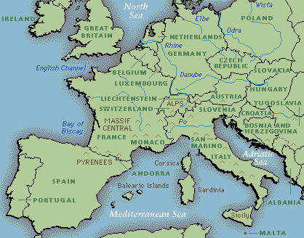



Intranet and Cloud Network Solutions
High-bandwidth connections between servers.
Standard Internet connections to users.

Slide 47
Decentralization Summary
Organizational
Are operations interdependent?
-planning
-development
-physical resources
-operations
Can subunits relate solely through information & messages?
Does corporate culture support decentralization?
Strengths
End users gain control.
Supports workgroups.
Enables new organizational structures.
Increased organizational flexibility.
Weaknesses
Possible short term bias in decision making.
Might not be optimal use of resources for corporation.
IS staff might lose cohesiveness and support.

Slide 48
Technology Toolbox: Defining E-Mail Rules
Create folders.
Tools/Rules and Alerts
New Rule, options
Move to folder

Slide 49
Quick Quiz: Defining E-Mail Rules
1. How is the e-mail system similar to an expert system? How is it different?
2. What is likely to be the most difficult part of creating a system for handling your messages?

Slide 50
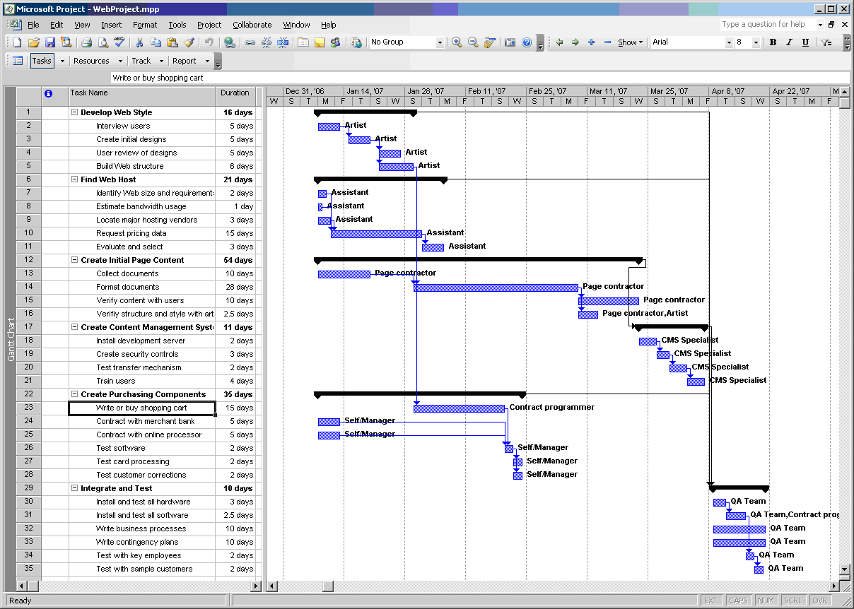
Technology Toolbox: Managing Projects
Microsoft Project
WebProject.mpp
WebProjectLevel.mpp

Slide 51
Quick Quiz: Managing Projects
1. What advantages are provided by storing the project information in a DBMS?
2. Why is estimating development time one of the most difficult activities?

Slide 52
Cases: Energy

